Slide 1
Graphs

Slide 2
A classical problem
Now I have N friends, but I have the phone numbers of some of them only
I want to deliver a message to Sarah by repeated calling
My memory is so good that I remember who can be contacted by my N friends
Give me a calling plan for me and my friends

Slide 3
A classical problem
This is actually a graph!
Winnie
Ryan
Gary
Ada
Joyce
John
Sarah

Slide 4
What is a graph?
A set of vertices (or nodes) linked by edges
Mathematically, we often write G = (V,E)
V: set of vertices, so |V| = number of vertices
E: set of edges, so |E| = number of edges
1
3
2
5
4

Slide 5
What is a Graph?
A graph G = (V,E) is composed of:
V: set of vertices
E: set of edges connecting the vertices in V
An edge e = (u,v) is a pair of vertices
Example:
a
b
V= {a,b,c,d,e}
E= {(a,b),(a,c),(a,d),
(b,e),(c,d),(c,e),
(d,e)}
c
d
e

Slide 6
Why do we need graphs?
To present the relationships between different objects/elements in a mathematical way
Examples:
Friendship
Local Area Network (LAN)
Map of a country
What could the vertices and edges represent in the above examples?

Slide 7
Applications
electronic circuits
networks (roads, flights, communications)
CS16
JFK
LAX
LAX
STL
HNL
DFW
FTL

Slide 8
Various types of graphs
Directed/undirected(digraph) graphs
You may treat each undirected edge as two directed edges in opposite directions
Undirected: edge (u, v) = (v, u), (No self loops.)
Directed(Digraph): (u, v) is edge from u to v, denoted as u → v. (Self loops are allowed).

Slide 9
Degree of a Vertex
For undirected graph
The degree of a vertex is the number of edges incident to that vertex.
For directed graph,
the in-degree of a vertex v is the number of edges coming to have v as the head
the out-degree of a vertex v is the number of edges that have v as the tail

Slide 10
Examples
0
3
2
0
1
2
3
3
3
1
2
3
3
5
6
4
G2
3
1
1
1
1
3
G1
0
in:1, out: 1
directed graph
in-degree
out-degree
1
in: 1, out: 2
2
in: 1, out: 0
G3

Slide 11
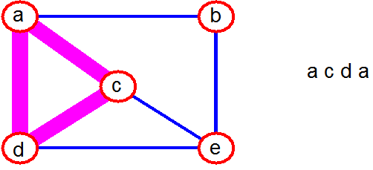
Graph Terminology
simple path: no repeated vertices
cycle: simple path, except that the last vertex is the same as the first vertex
a
b
b e c
c
d
e

Slide 12
Graph Terminology
For Undirected Graph
cycle: simple path, except that the last vertex is the same as the first vertex
For Digraph
Loop: An edge terminates at the same vertex from which it has started
a
b
adca
c
d
e

Slide 13
Representation of Graphs
Two standard ways.
Adjacency Lists.
Adjacency Matrix.
a
b
a
b
d
c
b
a
c
c
d
c
d
a
b
d
a
c
1
2
1 2 3 4
1 0 1 1 1
2 1 0 1 0
3 1 1 0 1
4 1 0 1 0
a
b
c
d
3
4

Slide 14
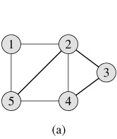
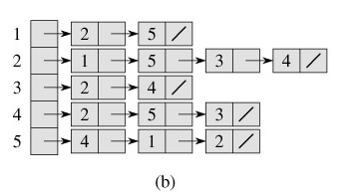
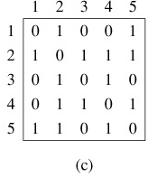
Graph representation – undirected
graph
Adjacency list
Adjacency matrix

Slide 15
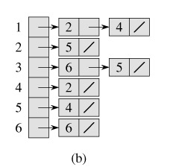
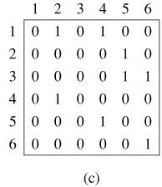
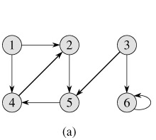
Graph representation – directed
graph
Adjacency list
Adjacency matrix

Slide 16
Connected Graph-Undirectedtivity
An undirected graph is said to be connected if there is a path between every pair of nodes. Otherwise, the graph is disconnected.
Informally, an undirected graph is connected if it hangs in one piece
Disconnected
Connected

Slide 17

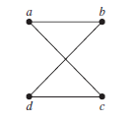
Draw a graph with the adjacency matrix.

Slide 18
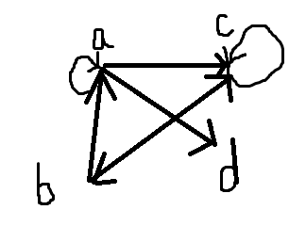
Draw a graph of the following adjacency matrix.
1 | 0 | 1 | 1
1 | 0 | 1 | 0
0 | 1 | 1 | 0
0 | 0 | 0 | 0

Slide 19
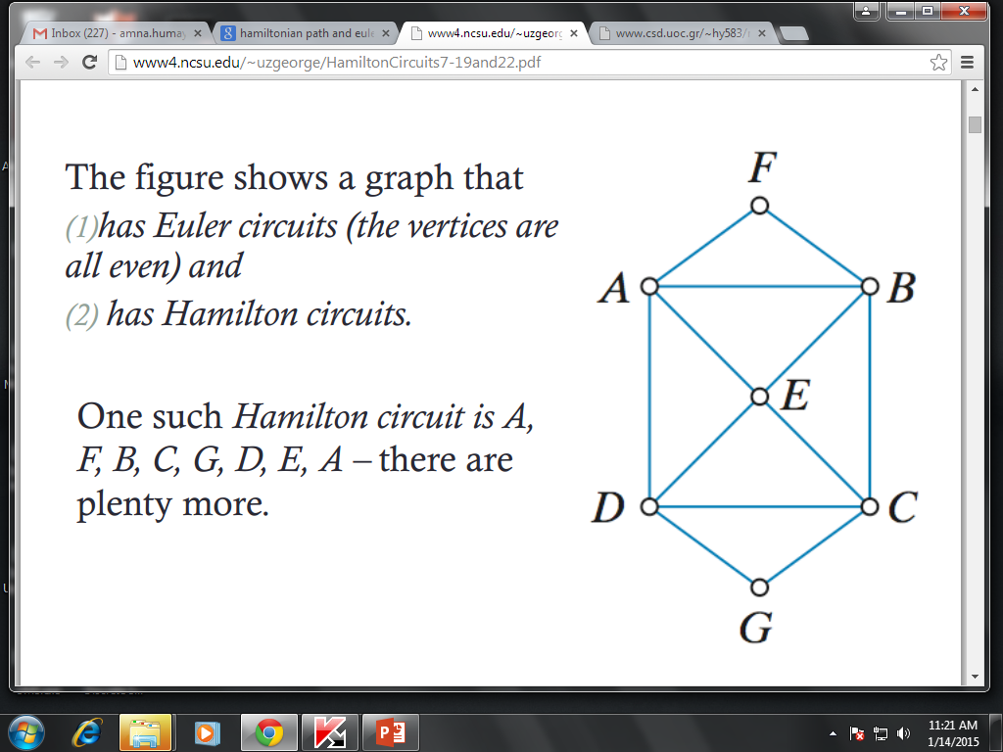
Hamiltonian Path and Hamiltonian Cycle( Circuit)
A Hamiltonian path (or traceable path) is a path in an undirected or directed graph that visits each vertex exactly once.
A Hamiltonian cycle (or Hamiltonian circuit) is a graph cycle (i.e., closed loop) that visits each vertex exactly once (except for the vertex that is both the start and end, which is visited twice).
A graph that contains a Hamiltonian cycle is called a Hamiltonian graph.
Hamilton Path is A,F, B, C, G, D, E
Hamilton circuit is A,F, B, C, G, D, E, A

Slide 20
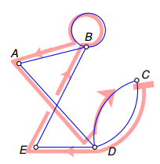
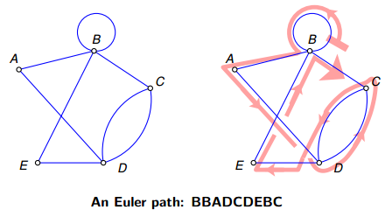
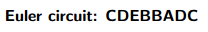
Euler Path and Hamiltonian Cycle( Circuit)
An Euler path is a path that uses every edge of a graph exactly once.
An Euler circuit is a circuit that uses every edge of a graph exactly once.
An Euler path starts and ends at different vertices.
An Euler circuit starts and ends at the same vertex.

Slide 21
Eulerian circuit traverses every edge exactly once, but may repeat vertices, while a Hamiltonian circuit visits each vertex exactly once but may repeat edges.

Slide 22
Special graphs
Tree: either one of the followings is the definition
A connected graph with |V|-1 edges
A connected graph without cycles
A graph with exactly one path between every pair of vertices

Slide 23
Special graphs
Tree edges could be directed or undirected
For trees with directed edges, a root usually exists

Slide 24
Assignment
Exercise 10.5
Q1
Q2
Q3
Q5
Q7
Q31
Q33
Q35

